Slide 1

IOD – Mini project 1 hdb resales prices
17 July 2021
Prepared by Jeff koh

Slide 2
Requirement statement
A couple in their mid 30s has engaged us to source for a housing unit in the resale flat.
They were keen to look at area in Jurong West, however they would like to have the following data before deciding.
Singapore HDB resales record for past 10 years in the region.
Average selling price in each region*.
Average selling price for a 5 room flat that is more then 10 years old in Jurong West.
Average selling price for a 5 room flat that is below 10 years old in Jurong West.
Common square meter size for a 5 room flat in Jurong West.
*https://va.ecitizen.gov.sg/CFP/CustomerPages/NEA_google/displayresult.aspx?MesId=1068932&Source=Google&url=va.ecitizen.gov.sg

Slide 3
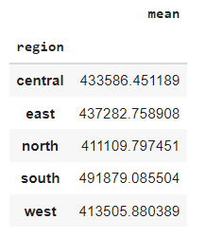
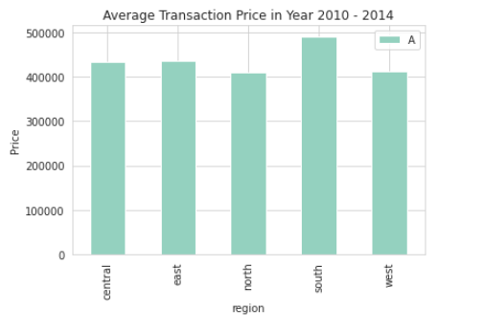
Average Transaction price between 2010 - 2014
AMONG THE 5 REGION - SOUTH HAS THE HIGHEST TRANSACTION.

Slide 4
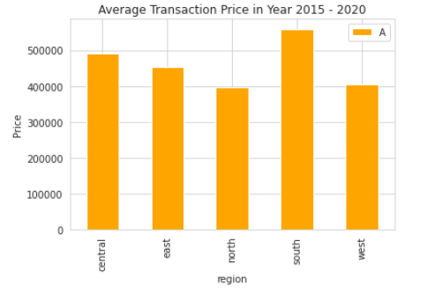
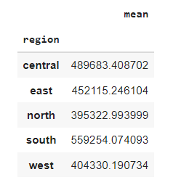
Average Transaction price between 2015 - 2020
- As compare with the previous graph south region maintain with the highest average transaction.

Slide 5
conclusion
The common sqm size for a 5 room HDB flat in Jurong West is 110.
The average selling price for a 5 room flat that is more then 10 years old is $446,332.
The average selling price for a 5 room flat that is below 10 years old is $470,653.
As the flat gets older, the value of the house gets lower.

